Slide 2
Machine Learning results on MB FPAs - Are there magnets with abnormal behavior?
Christoph Obermair, TE-MPE-CB
Acknowledgement:
Marvin Janitschke, TE-MPE-PE
Emmanuele Ravaioli, TE-MPE-PE
Mariusz Wozniak, TE-MPE-PE
Zinour Charifoulline, TE-MPE-PE
Lukas Felsberger, TE-MPE-MI
Daniel Wollmann, TE-MPE-CB
Aleksandra Mnich, TE-MPE-CB
Franz Pernkopf, TU-Graz

Slide 3
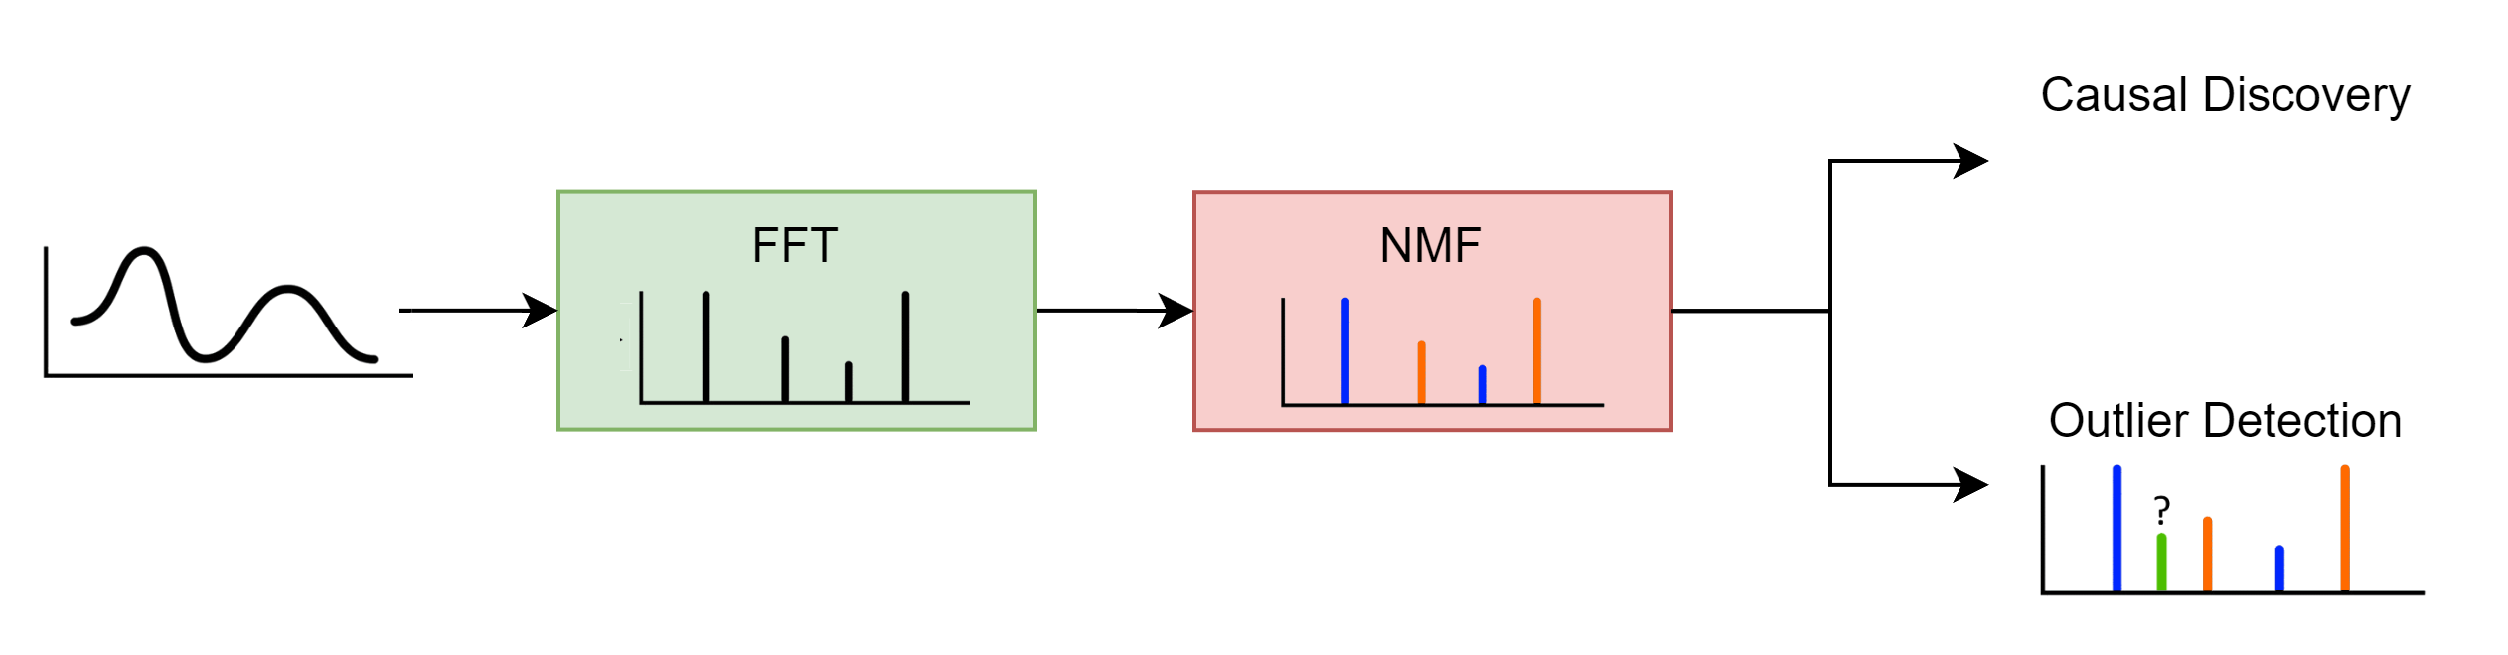
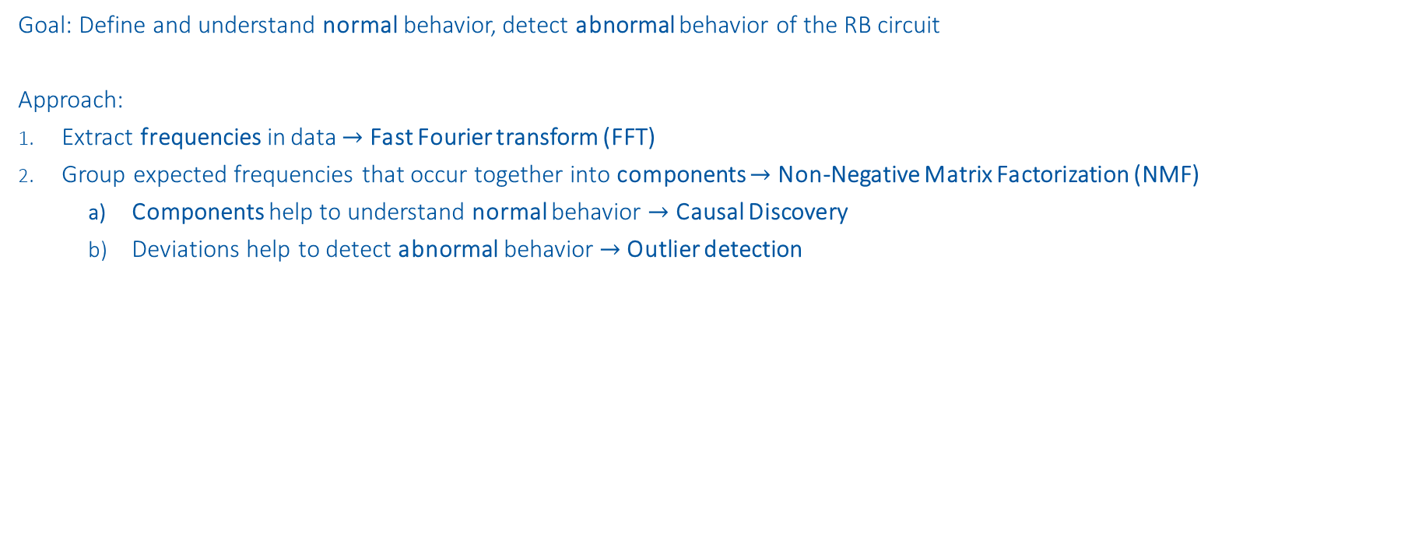
Outline
Goal: Define and understand normal behavior, detect abnormal behavior of the RB circuit
Approach:
Extract frequencies in data $→$ Fast Fourier transform (FFT)
Group expected frequencies that occur together into components $→$ Non-Negative Matrix Factorization (NMF)
Components help to understand normal behavior $→$ Causal Discovery
Deviations help to detect abnormal behavior $→$ Outlier detection

Slide 4
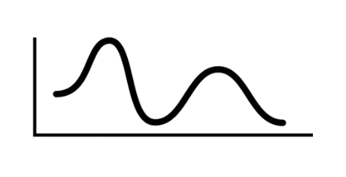
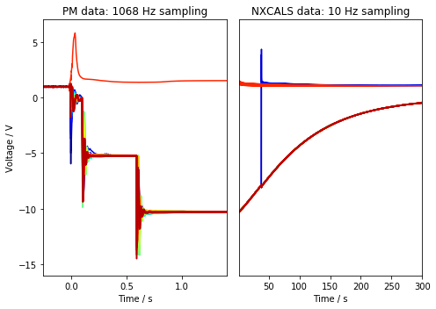
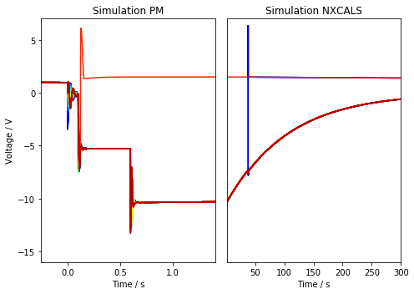
Select data
Signal: U_diode from nQPS in PM
Region: Plateaus after energy extraction
Period: 2021, Quench* (425 events) + Snapshot data (64 events)
Data size: 489 events x 154 magnets x
1st EE Plateau: 317 samples (0.295s)
2nd EE Plateau: 648 samples (0.606s)
Selection criterion:
Unusual behavior (“Wiggle”) in U_diode of RB.A78 B28L8 on 2021-03-28
PM data available in high resolution (1068Hz)
EE is similar to transient measurement
Deviation from data and simulations during plateaus
1st EE
Plateau
2nd EE
Plateau
*simulations done by Marvin Janitschke with STEAM framework
* No events with fast secondary quenches (135 events)

Slide 5
Fast Fourier transform
Extract frequencies in data

Slide 6
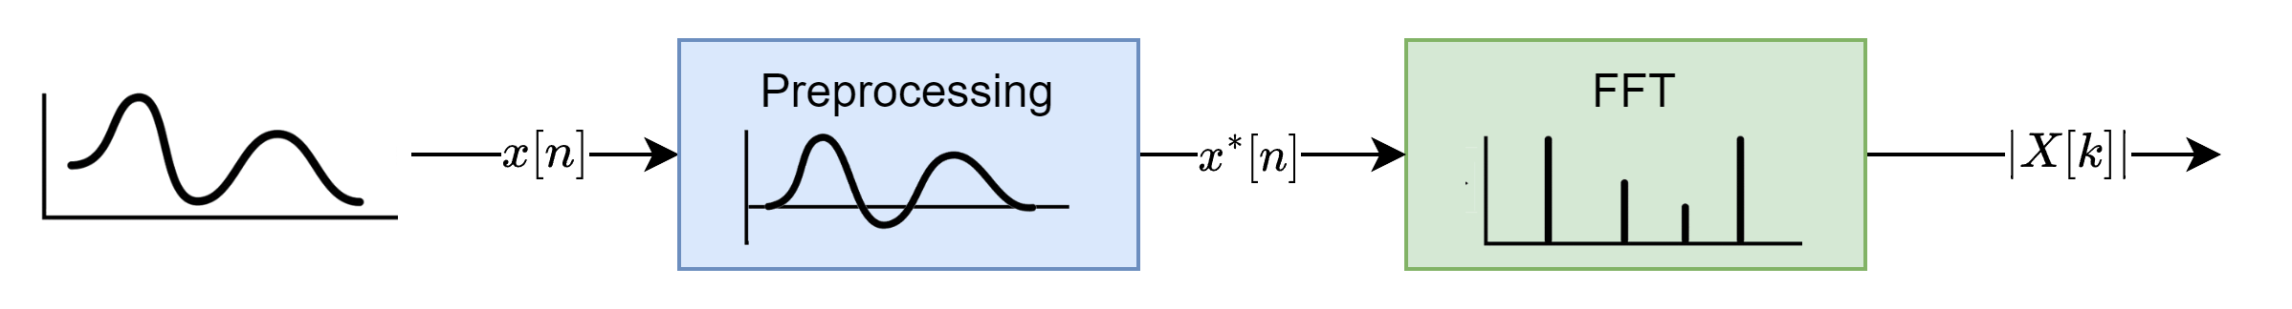
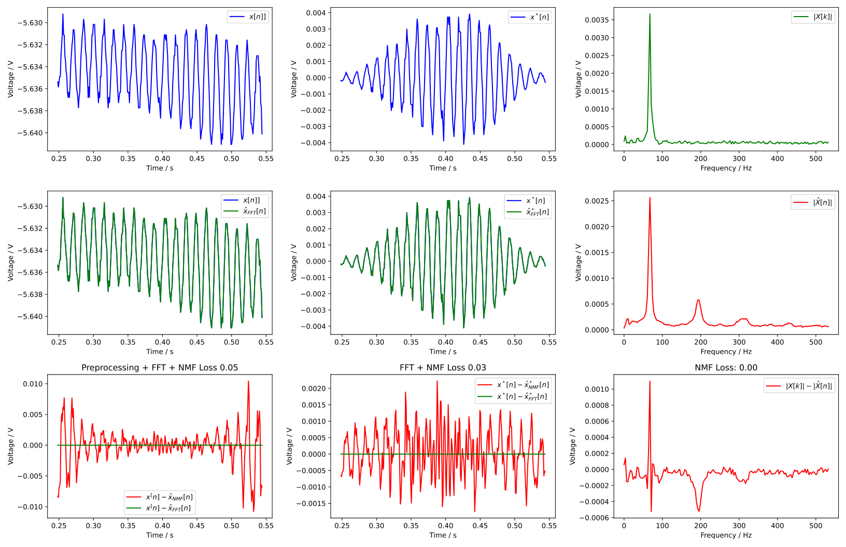
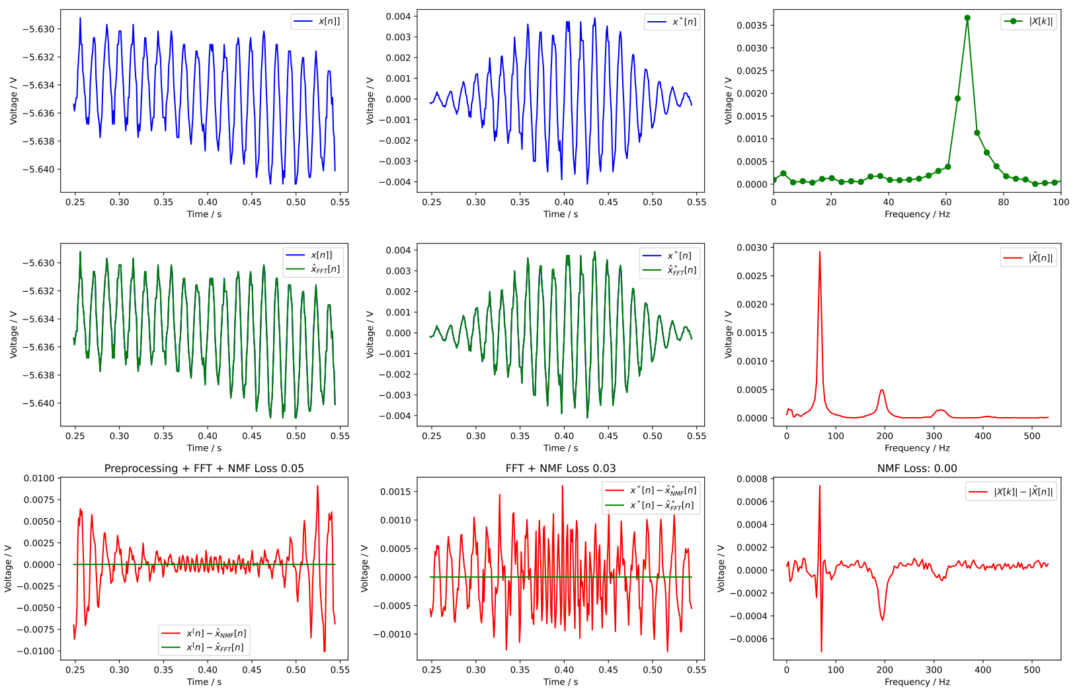
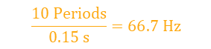

Fast Fourier transform
Example signal: B21R3 on 2021-04-18 08:44:17
Preprocessing necessary to minimize spectral leakage:
Subtract offset
Multiplication with window
$$\frac{10 Periods}{0.15 s}=66.7 Hz$$
$$67.4 Hz$$

Slide 7
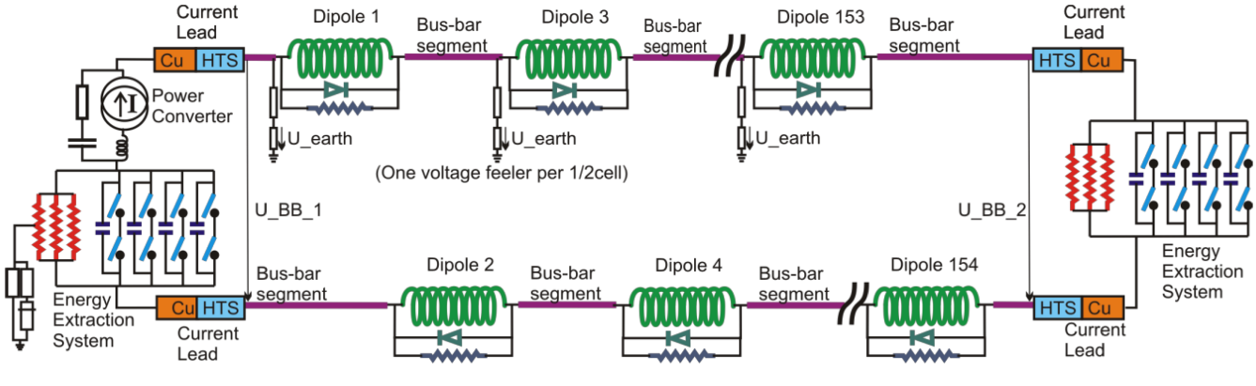
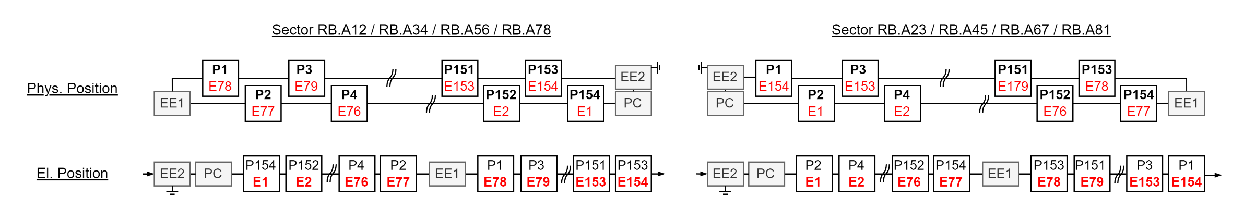
El. Vs Phys. Position

Slide 8
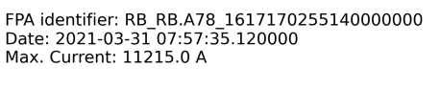
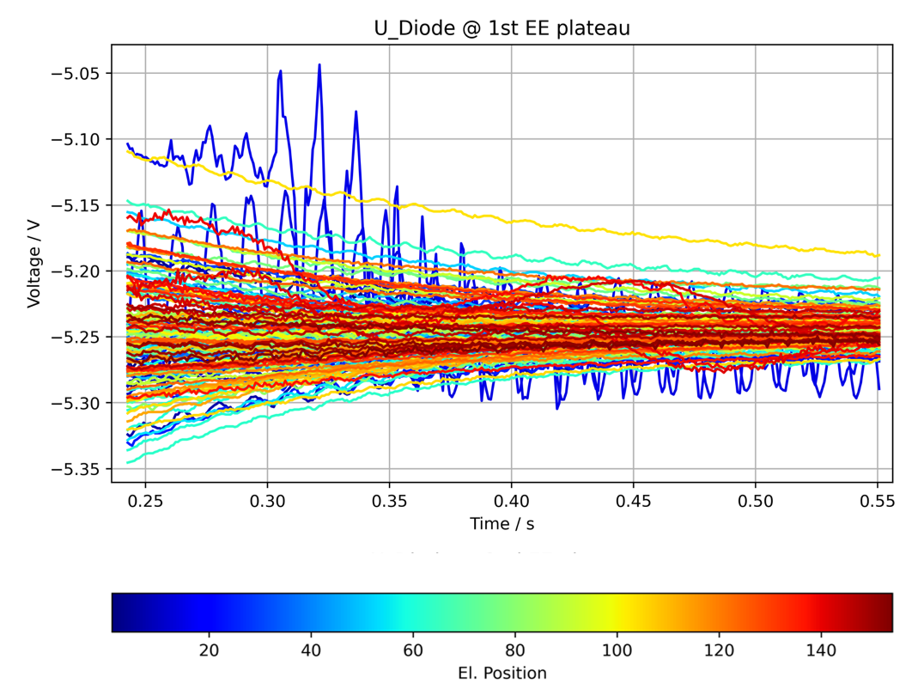
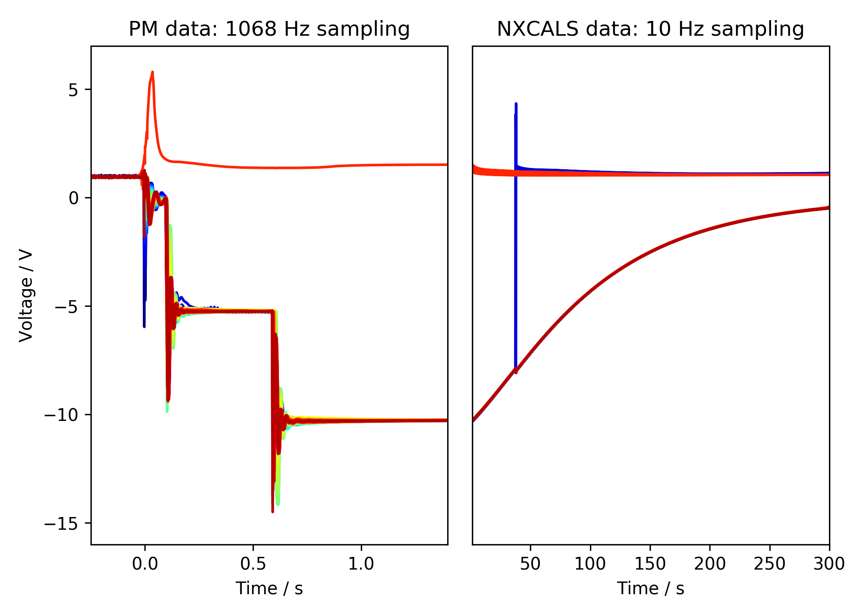
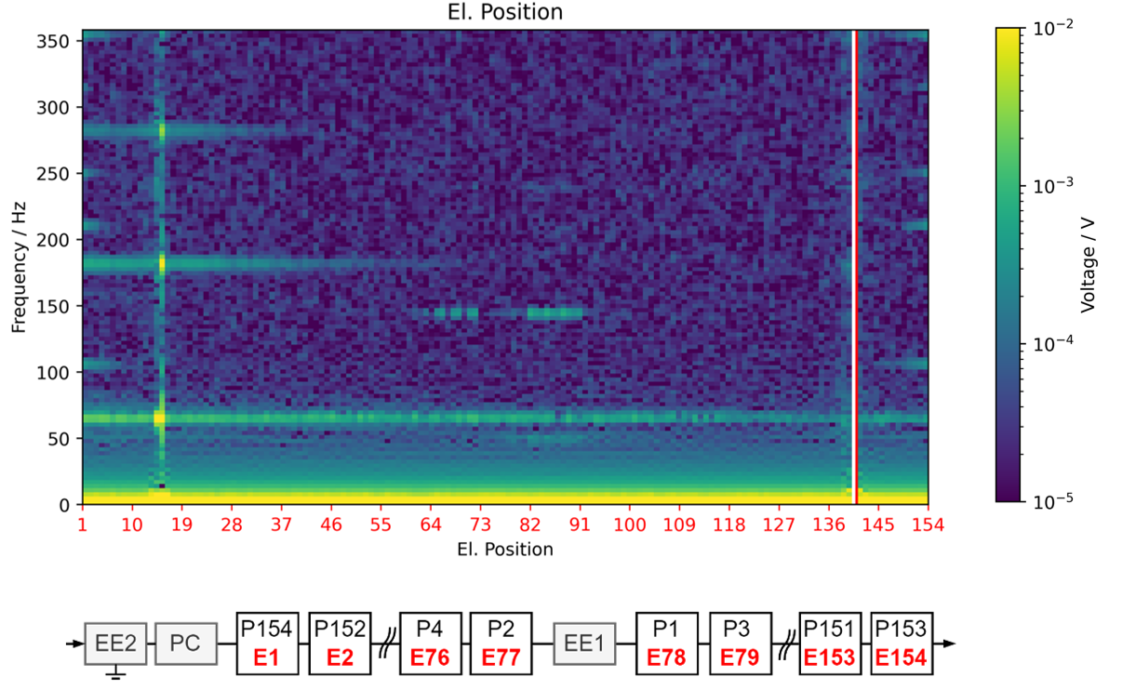
Frequency Position Maps (FPM)
Normal event
1st EE
Plateau
fft
2nd EE
Plateau
2nd EE switch off
1st EE switch off
PC Switch off

Slide 9
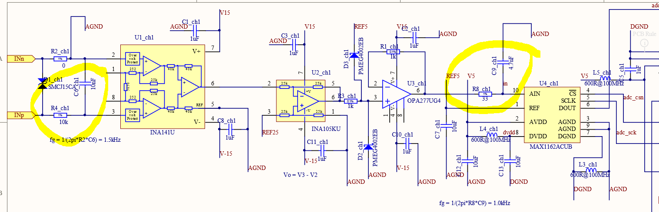
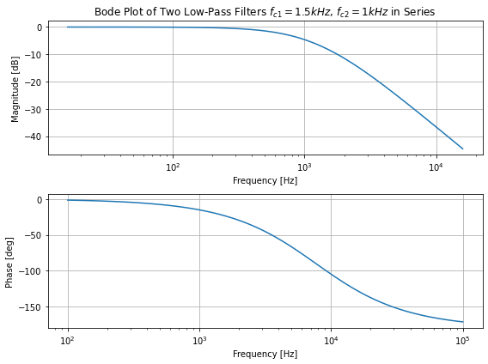
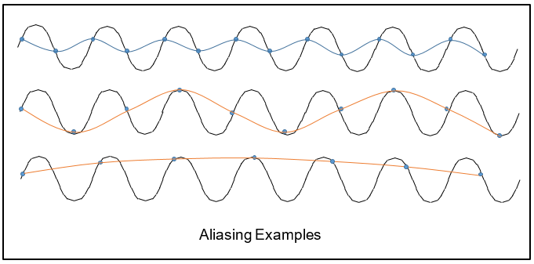
Aliasing
1.5kHz 1st Order lowpass direkt am Eingang und dann noch einen zweiten mit 1kHz vor dem ADC
High frequency components could potentially cause aliasing in results.
Anti-aliasing filters in the nQPS crates:
Two 1st order lowpass filters with 1.5 kHz and 1 kHz cutoff frequency*
Sampling frequency of nQPS crates: 1068 Hz
*provided by Jens Steckert

Slide 10
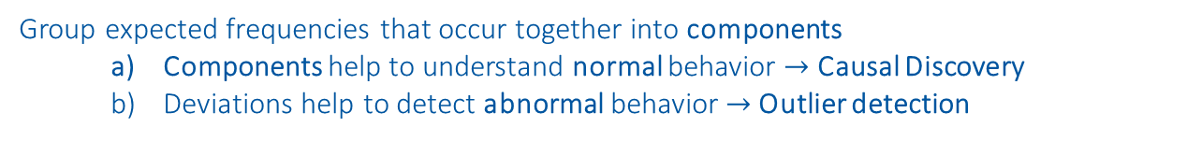
Non-Negative Matrix Factorization (NMF)
Group expected frequencies that occur together into components
Components help to understand normal behavior $→$ Causal Discovery
Deviations help to detect abnormal behavior $→$ Outlier detection
https://www.nature.com/articles/44565
https://proceedings.neurips.cc/paper/2000/file/f9d1152547c0bde01830b7e8bd60024c-Paper.pdf

Slide 11
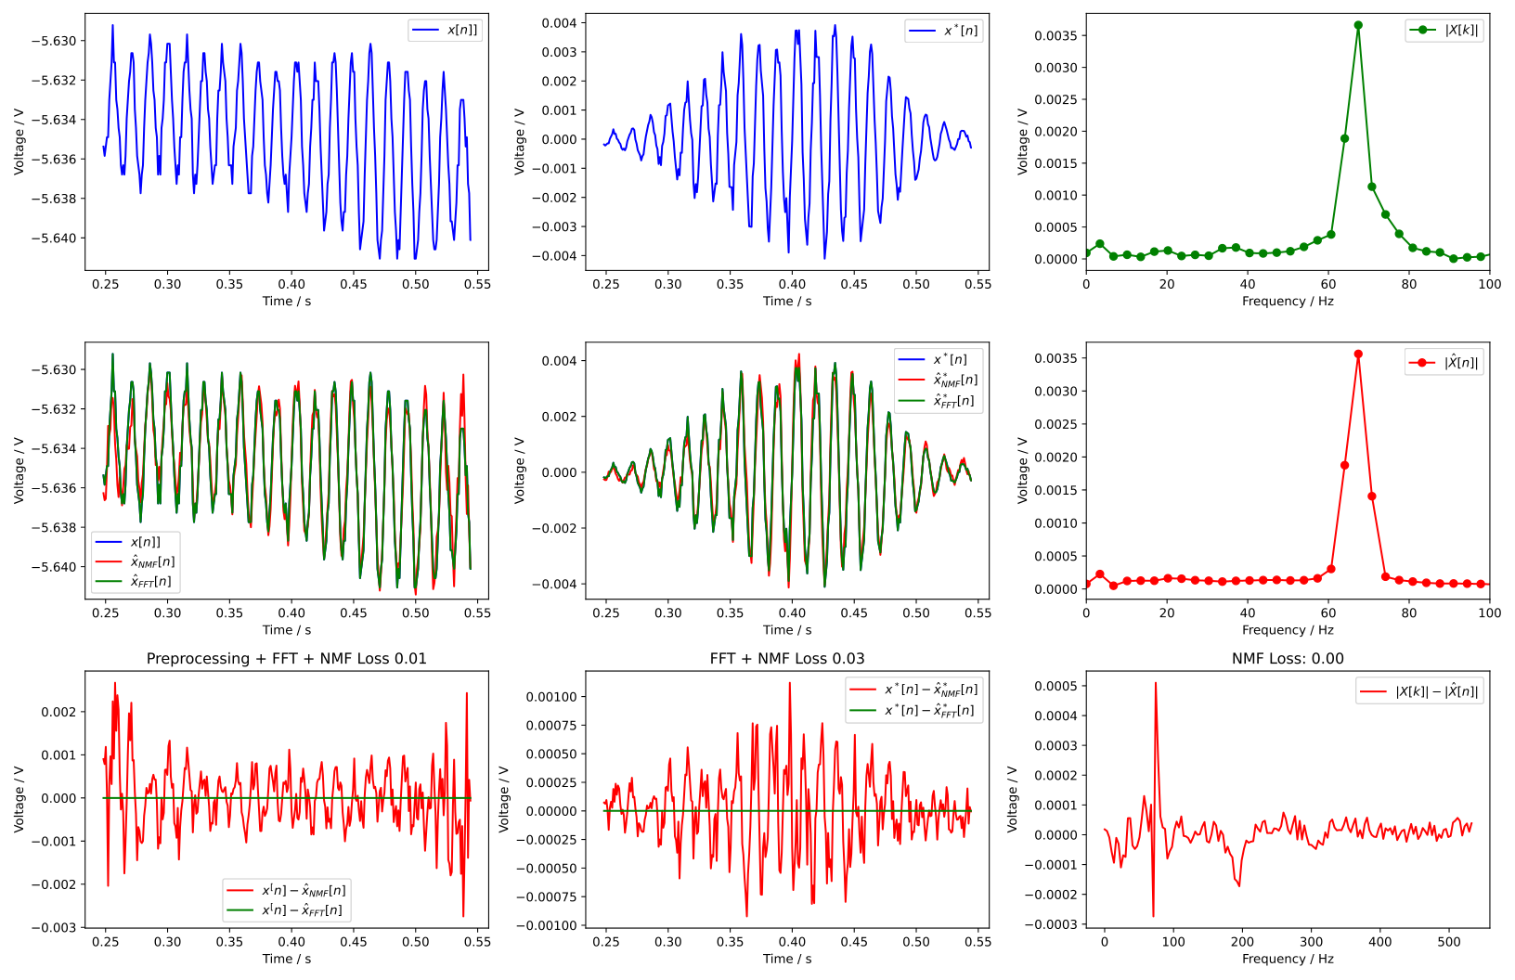
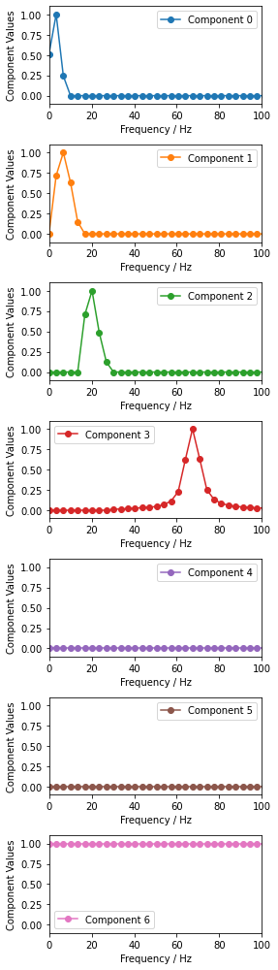
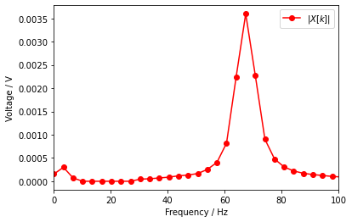

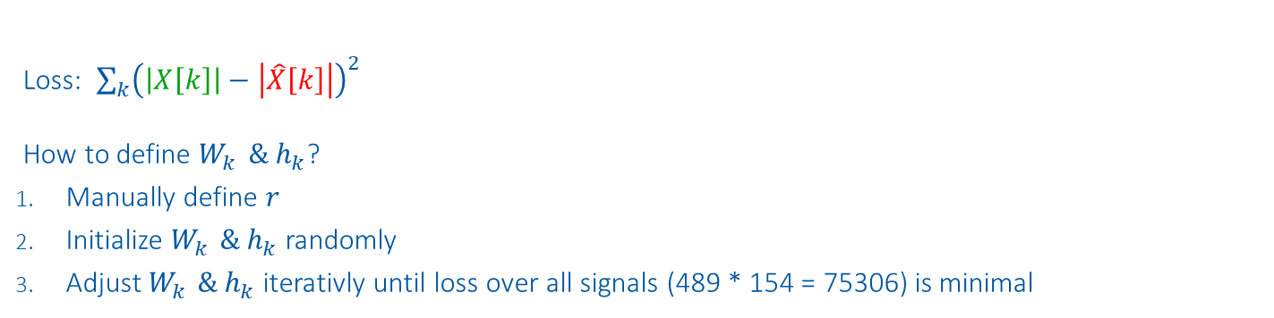
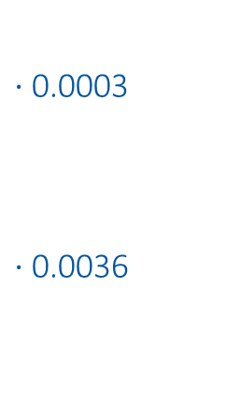
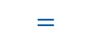
Method
Components
Weights
Input
Reconstruction
$$\left|X\left[k\right]\right| ≈ \sum_{k=1}^{r}{{ W}_{k }{⋅ h}_{k} = |\hat{X}[k]|}$$
$⋅$0.0003
$⋅$0.0036
$$≈$$
$$=$$
Loss: $\sum_{k}{{\left(\left|X\left[k\right]\right|−\left|\hat{X}\left[k\right]\right|\right)}^{2}}$
How to define $W_{k }{\& h}_{k}$?
Manually define $r$
Initialize $W_{k }{\& h}_{k}$randomly
Adjust $W_{k }{\& h}_{k}$iterativly until loss over all signals (489 * 154 = 75306) is minimal
Example signal: B21R3 on 2021-04-18 08:44:17

Slide 12
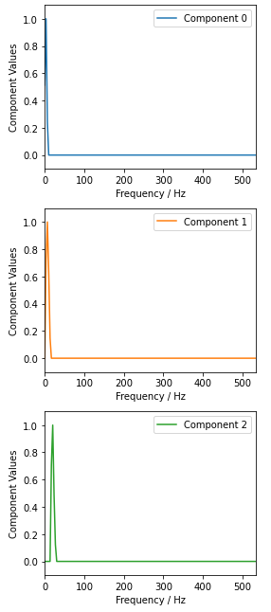
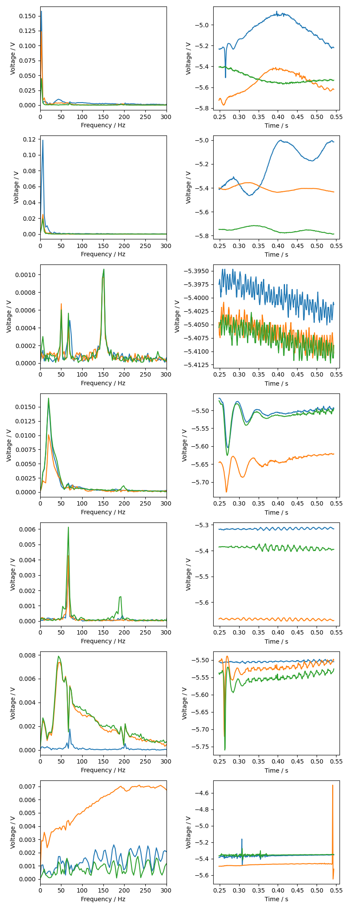
NMF Components
Component Index | Component | 3 Event Examples | Dominant Frequencies | Order of magnitude
0* |  |  | 3 Hz | 100mV
1 |  |  | 6 Hz | 100mV
2 |  |  | 20 Hz | 10mV

Slide 13
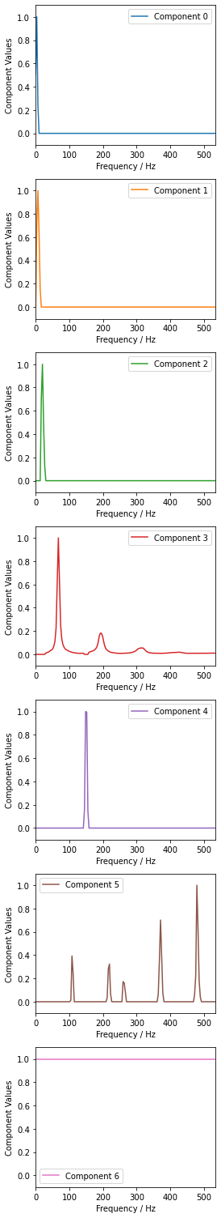
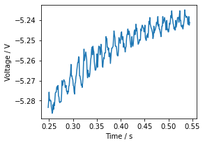
Component Index | Component | 3 Event Examples | Dominant Frequencies [Hz] | Order of magnitude
3 |  |  | 67 Hz 184 Hz 302 Hz | 100mV
4 |  |  | 148 Hz | 1mV
5 |  |  | 107 Hz 220 Hz 260 Hz 370 Hz 478 Hz | 0.1mV
6 |  |  | Any | 100mV

Slide 14
Causal Discovery
Understand normal behavior

Slide 15
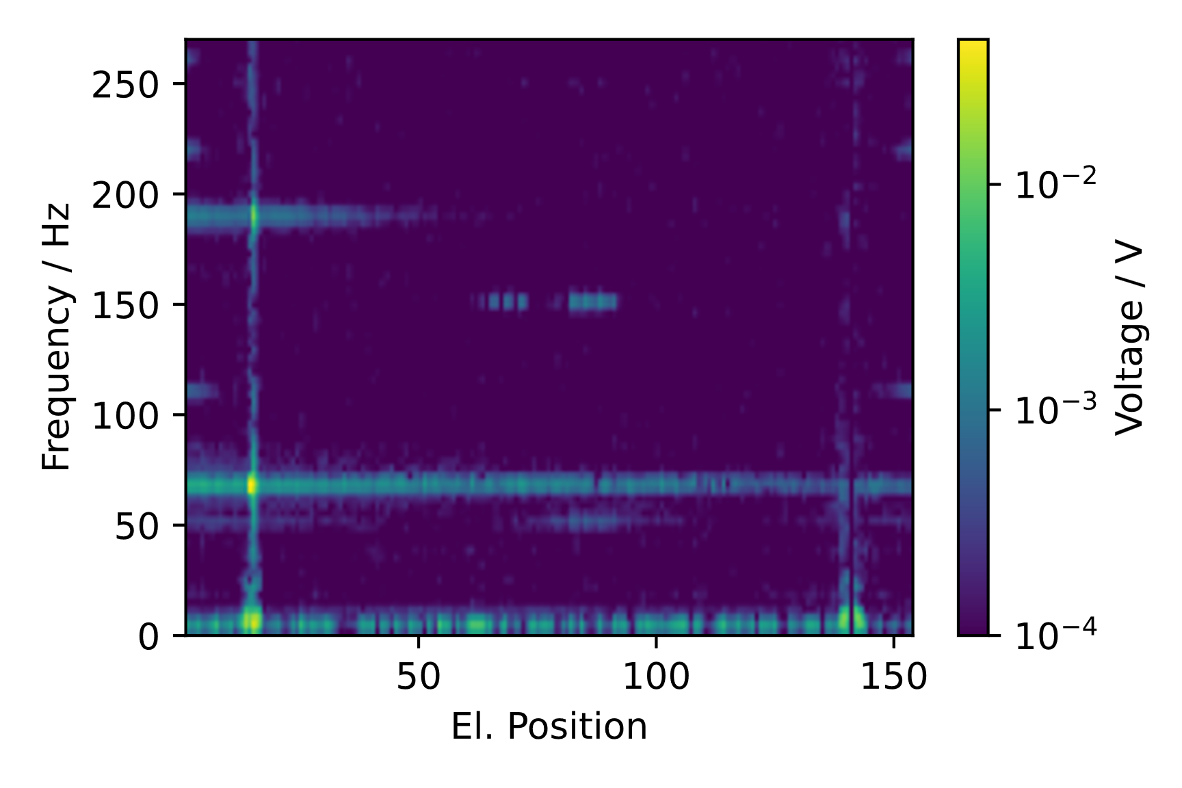
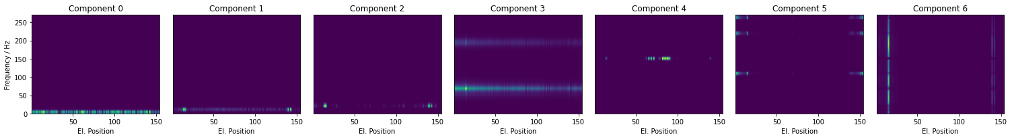







FPM of Components
Normal event
Frequency components along all magnets in event
$$≈$$
$$+$$
$$+$$
$$+$$
$$+$$
$$+$$
$$+$$
3Hz
6Hz
20Hz
65Hz
143Hz
478Hz
Any
Electromagnetic perturbation + FFT smiring
Source Direction: Quench
Propagation: Physical
Electromagnetic perturbation
Source Direction: Quench
Propagation: Physical
Left over of voltage wave traveling along the chain of magnets by magnet inductance
Source Direction: Quench
Propagation: Physical
Oscillations caused by quench
Source Direction: Quench
Propagation: Electrical
Repetitive pattern within QPS crate, aliasing?
Source Direction: Quench
Propagation: QPS crate position
Oscillations from the direction of Power converter in RB.A78, aliasing?
Source Direction: Power converter in RB.A78
Propagation: Physical
Oscillations caused by quench
Source Direction: Quench
Propagation: Physical

Slide 16
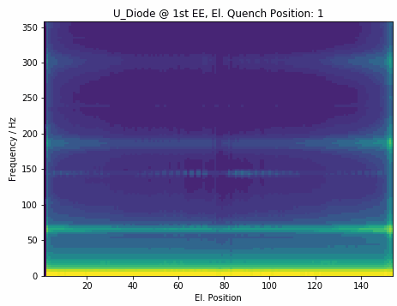
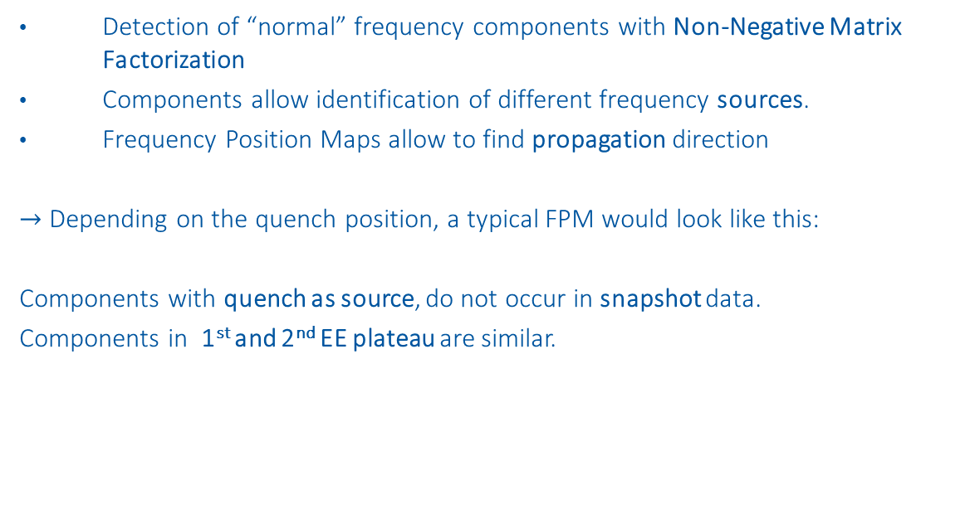
Conclusion Causal Discovery
Detection of “normal” frequency components with Non-Negative Matrix Factorization
Components allow identification of different frequency sources.
Frequency Position Maps allow to find propagation direction
$→$ Depending on the quench position, a typical FPM would look like this:
Components with quench as source, do not occur in snapshot data.
Components in 1st and 2nd EE plateau are similar.

Slide 17
Outlier Detection
Detect abnormal behavior

Slide 18
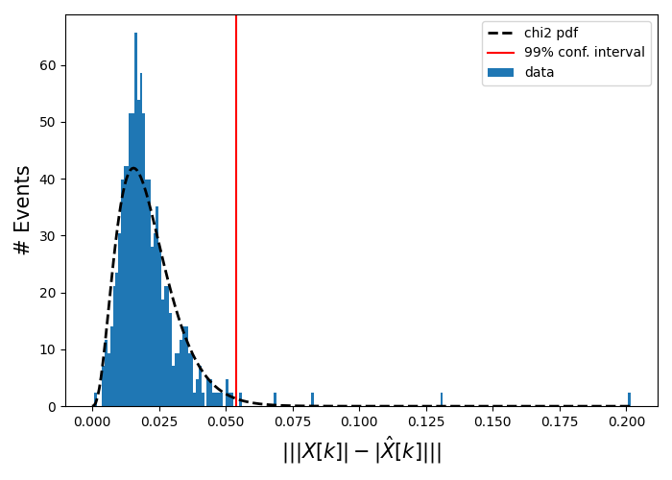
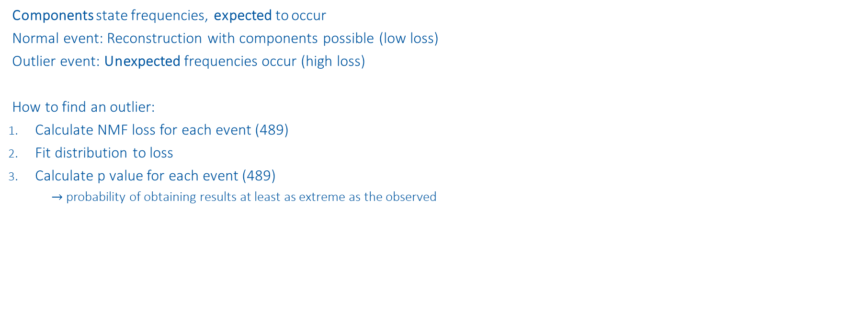
Approach
Normal event
Components state frequencies, expected to occur
Normal event: Reconstruction with components possible (low loss)
Outlier event: Unexpected frequencies occur (high loss)
How to find an outlier:
Calculate NMF loss for each event (489)
Fit distribution to loss
Calculate p value for each event (489)
$→$probability of obtaining results at least as extreme as the observed
Outliers
Normal

Slide 19
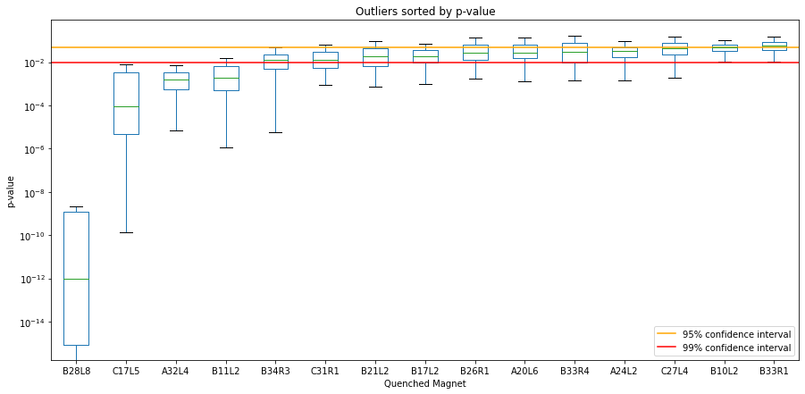
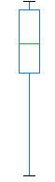
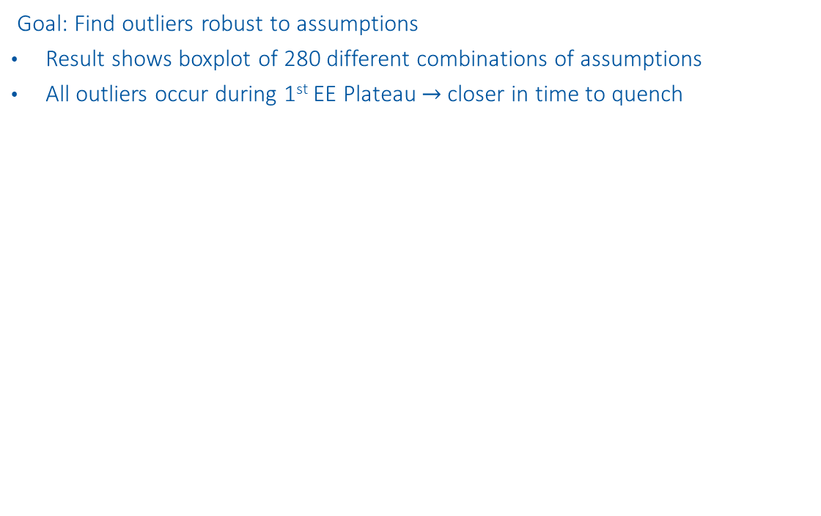
Outliers
Goal: Find outliers robust to assumptions
Result shows boxplot of 280 different combinations of assumptions
All outliers occur during 1st EE Plateau $→$closer in time to quench
Q3 + 1.5 * Box length
3rd Quantil (Q3)
Box length
Median
1st Quantil (Q1)
Q1 - 1.5 * Box length

Slide 20
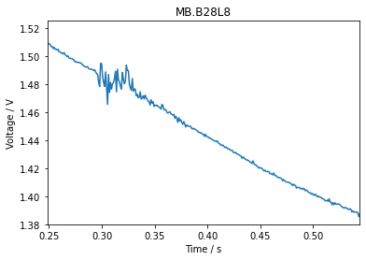
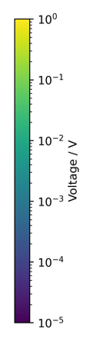
RB.A78 - B28L8 – Intercoil short
Event with B28L8 quench before:
2021-03-28: „normal“ at EE plateaus

Slide 21
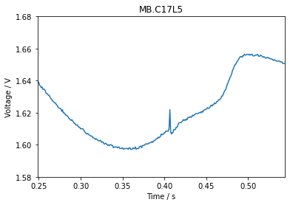
RB.A45 - C17L5
Events with C17L5 quench before:
2021-05-07: „normal“ at EE plateaus
2021-05-07: „normal“ at EE plateaus
A17L5, E89
B16L5, E88
C16L5, E66

Slide 22
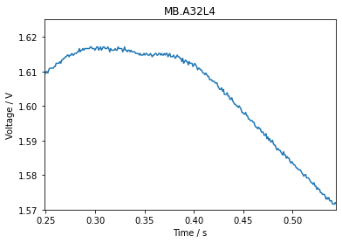
RB.A34 - A32L4
Events with A32L4 quench before:
2021-04-04: „normal“ at EE plateaus
2021-04-14: 3 fast sec. quenches
B33A4, E36
B33L4, E118
C32L4, E119
B32L4, E35

Slide 23
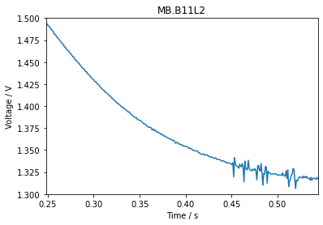
RB.A12 - B11L2
No B11L2 quench before
A11L2, E4
B10L2, E152
A9L2, E3
B9L2, E153

Slide 24
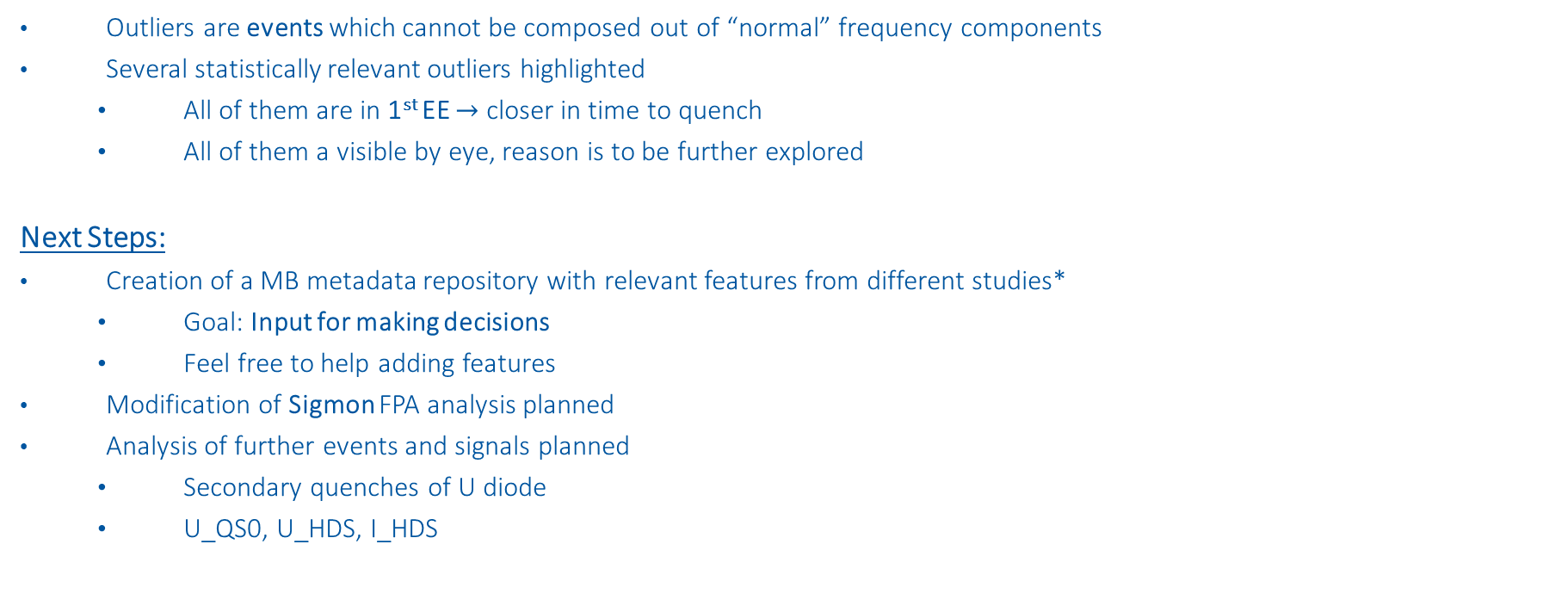
Conclusion Outlier Detection
Outliers are events which cannot be composed out of “normal” frequency components
Several statistically relevant outliers highlighted
All of them are in 1st EE $→$ closer in time to quench
All of them a visible by eye, reason is to be further explored
Next Steps:
Creation of a MB metadata repository with relevant features from different studies*
Goal: Input for making decisions
Feel free to help adding features
Modification of Sigmon FPA analysis planned
Analysis of further events and signals planned
Secondary quenches of U diode
U_QS0, U_HDS, I_HDS
*https://gitlab.cern.ch/machine-protection/mb-feature-classification

Slide 26
Backup Slides

Slide 27
Fast Fourier transform

Slide 28
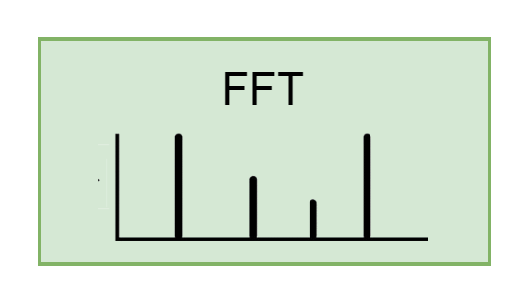
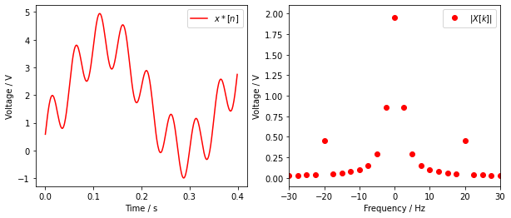
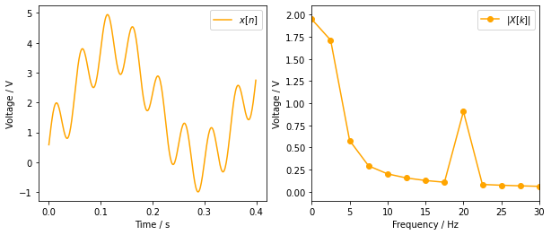
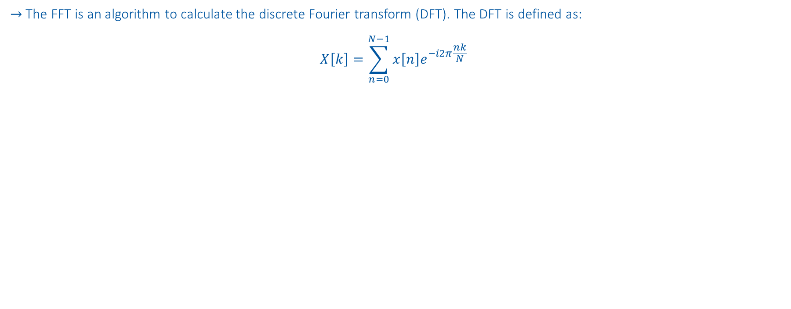
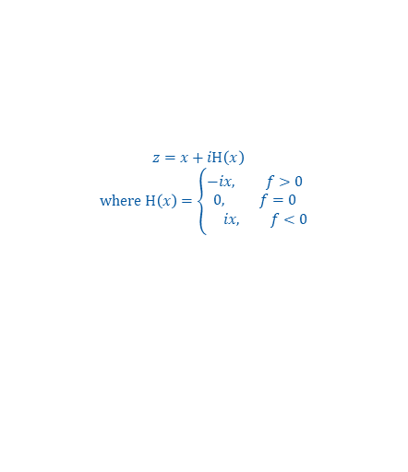
Fast Fourier transform
$→$The FFT is an algorithm to calculate the discrete Fourier transform (DFT). The DFT is defined as:
$$X\left[k\right]=\sum_{n=0}^{N−1}{x\left[n\right]e^{−i2π\frac{nk}{N}}}$$
$$x\left[n\right]=2V+2V∗sin(2π 3Hz∗n −90°) +sin(2π 20Hz∗n)$$
Apply Hilbert transform: Multiply all but first sample of FFT amplitude with 2
$z=x+iH\left(x\right)$
$$where H\left(x\right)=\left\{\begin{aligned}−i&x, f>0 \\ 0, f=0 \\ &ix, f<0\end{aligned}\right.$$
Smearing

Slide 29
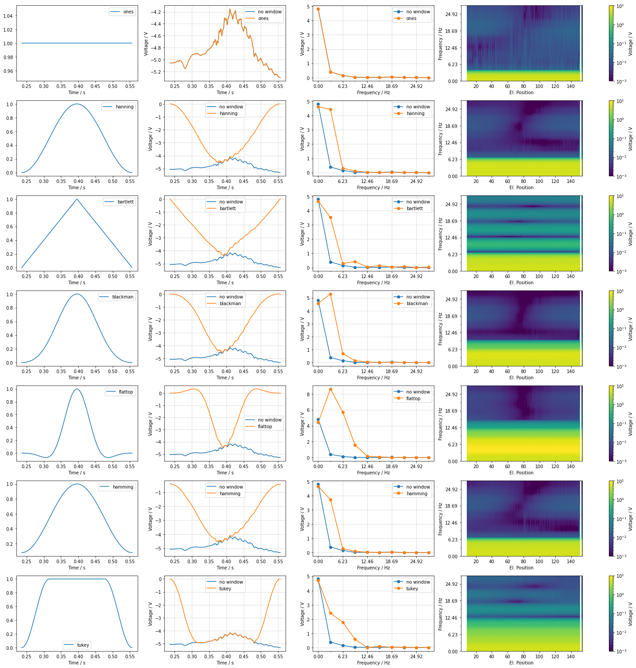




Window data
$→$ Avoid smearing
$$x\left[n\right]=2V+2V∗sin(2π 3Hz∗n −90°) +sin(2π 20Hz∗n)$$
Use Window:
$x^{∗}\left[n\right]=$ $x\left[n\right]∗w[n]$
Wrong Amplitude
Smearing
Add Window gain: Divide $|X\left[k\right]|$ with $\frac{1}{N}\sum_{n}^{N}{w[n]}$
Smearing from DC

Slide 30


Detrend data
$→$Smearing of DC component interferes with low frequency component
$$x\left[n\right]=2V+2V∗sin(2π 3Hz∗n −90°) +sin(2π 20Hz∗n)$$
Smearing from DC
Subtract trend:
$x^{∗}\left[n\right]=$ $(x\left[n\right]−{(p}_{1}n+p_{0}))∗w[n]$

Slide 31


Backwards Path
Signal: B21R3 on 2021-04-18 08:44:17
$$\frac{10 Periods}{0.15 s}=66.7 Hz$$
$$67.4 Hz$$

Slide 32
Non-Negative Matrix Factorization (NMF)
https://www.nature.com/articles/44565
https://proceedings.neurips.cc/paper/2000/file/f9d1152547c0bde01830b7e8bd60024c-Paper.pdf

Slide 33









Objective Function
$$V≈ WH$$
$m …$ number of $i$events * positions (560 x 154)
$n …$ number of frequencies (0-360Hz)
$r …$ number of components (1-5)
$V∈ℝ_{+}^{n×m}$… reconstructed event at position
$W∈ℝ_{+}^{n×r}$… components
$H∈ℝ_{+}^{r×m}$… presence of components
NMF Objective Function:
$\underset{W,H}{\min{ }}f\left(W, H\right)≡\frac{1}{2}{\left\|V−WH\right\|}_{F}^{2}$, s.t. $W, H≥0$
$$≈\sum_{k=1}^{r}{ }$$
$$⋅$$
$$=\sum_{k=1}^{r}{ }$$
$$=$$
$$⋅$$
$$⋅$$
$$⋅$$
$$⋅$$

Slide 34


Backwards Path
Signal: B21R3 on 2021-04-18 08:44:17

Slide 35
Causal Discovery

Slide 36




Component 0 & 1: EM Perturbation
Filter: 20ms moving average
dV is measured similar to sunglass threshold
dV
dV

Slide 37


Component 4 & 5

Slide 38
Outlier Detection

Slide 39
Assumptions
Assumptions for this plot:
Linear detrend
Hamming window
4 components
Frobenius distance
Preprocessing:
Degree of detrend:
0 - Offset
1 - Linear Trend
Window multiplication:
none (best reconstruction, high smearing)
hanning (lowest smearing, no reconstruction)
hamming (low smearing , good reconstruction)
barlett
blackman
flattop (high smearing, accurate amplitude)
tukey
NMF:
n_components (2-12)
Distance measure*:
Frobenius (Eu)
Kullback-Leibler (KL)
280 x
* https://ieeexplore.ieee.org/stamp/stamp.jsp?arnumber=6410389

Slide 40
RB.A34 - A32L4 – Event before

